Slide 1

Operating Systems
BCSC 0004
Semaphore

Slide 2



Semaphore
Semaphore was proposed by Dijkstra in 1965 to manage concurrent processes by using a simple integer value, known as a semaphore.
Semaphore is simply an integer variable which is non-negative and shared between threads.
This variable is used for critical section in the multiprocessing environment.
It uses two basic function wait(S) and Signal(S).
wait (S):
while S≤ 0 do no-op;
S--;
signal (S):
S++;

Slide 3
Critical Section of n Processes
Shared data:
semaphore mutex; //initially mutex = 1
Process Pi:
do {
wait(mutex);
critical section
signal(mutex);
remainder section
} while (1);
wait (S):
while S≤ 0 do no-op;
S--;
signal (S):
S++;

Slide 4


Two Types of Semaphores
Binary Semaphore – This is also known as mutex lock. It can have only two values – 0 and 1. Its value is initialized to 1. It is used to implement the solution of critical section problem with multiple processes.
Counting Semaphore – Its value can range over an unrestricted domain. It is used to control access to a resource that has multiple instances
Can implement a counting semaphore S as a binary semaphore.

Slide 5
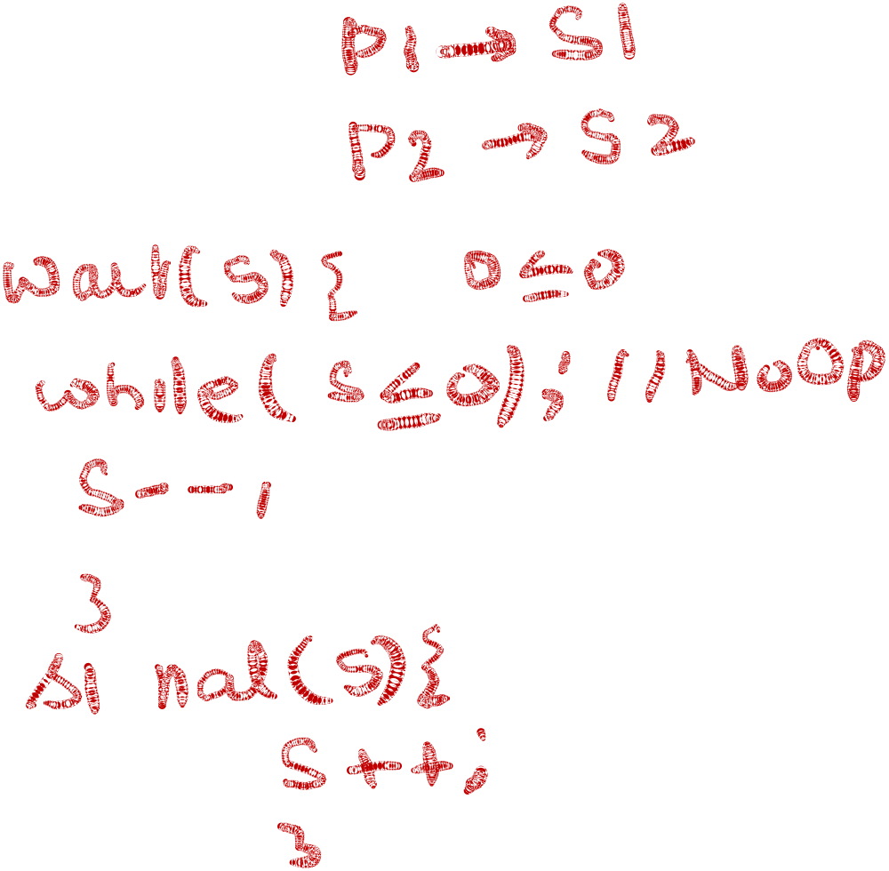


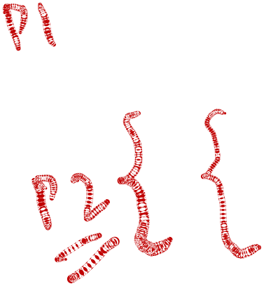

Example
There are TWO Processes P1 with Statement S1 and P2 with S2
CONDITION : S2 be executed only after S1. ( S1 →S2)
Semaphore synch←0;
        _______________________
        S1;
        Signal(synch);
        _______________________
        Wait(synch);
        S2;
        ________________________

Slide 6
Classical Problems of Synchronization
Producer Consumer with Bounded-Buffer Problem
Readers and Writers Problem
Dining-Philosophers Problem
Operating System Concepts

Slide 7
Producer Consumer with Bounded-Buffer
We have a buffer of fixed size.
A producer can produce an item and can place in the buffer.
A consumer can pick items and can consume them.
We need to ensure that when a producer is placing an item in the buffer, then at the same time consumer should not consume any item.
In this problem, buffer is the critical section.
To solve this problem, two counting semaphores – Full and Empty.
“Full” keeps track of number of items in the buffer at any given time and “Empty” keeps track of number of unoccupied slots.

Slide 8

Producer Consumer with Bounded-Buffer
Shared data : semaphore full, empty, mutex;
Initially: full = 0, empty = n, mutex = 1
do {
…
produce an item in nextp
…
wait(empty);
wait(mutex);
…
add nextp to buffer
…
signal(mutex);
signal(full);
} while (1);
do {
wait(full)
wait(mutex);
…
remove an item from buffer to nextc
…
signal(mutex);
signal(empty);
…
consume the item in nextc
…
} while (1);

Slide 9



Readers-Writers Problem
semaphore mutex, wrt;
Initially mutex = 1, wrt = 1, readcount = 0
wait(mutex);
readcount++;
if (readcount == 1)
wait(rt);
signal(mutex);
…
reading is performed
…
wait(mutex);
readcount--;
if (readcount == 0)
signal(wrt);
signal(mutex):
wait(wrt);
…
writing is performed
…
signal(wrt);

Slide 10








Dining-Philosophers Problem
Shared data
semaphore chopstick[5];
Initially all values are 1

Slide 11
Dining-Philosophers Problem
Philosopher i:
do {
wait(chopstick[i])
wait(chopstick[(i+1) % 5])
…
eat
…
signal(chopstick[i]);
signal(chopstick[(i+1) % 5]);
…
think
…
} while (1);

Slide 12


